Slide 2
Bullet Descriptions
Society destroys the character :
?To make you better?
?To make you worse?

Slide 3

Imagination Building and expressing yourself
Is society something helping us to build or destroy ourselves?
Henry Letellier
Notes:
Imagination (1ère) Building and expressing yourself (Tle)

Slide 4

Body of Documents
Of Mice and Men – John Steinbeck
Part I, chapter 1, 1984 – George Orwell
The Truman Show
Joker – A powerful psychological drama
Goodbye Lenin
The Importance of Being Earnest (Oscar Wilde)
Notes:
To do:
Add dates, directors

Slide 5
Society destroy’s you

Slide 6
Of Mice and Men When George shoots Lennie:
Notes:
Explaining “Of Mice and Men”
Lennie accidentally killed Curley’s wife
Destroyed the dream of their farm and animals.
George realizes what Lennie has done
hardest is yet to come
sworn an oath to protect Lennie as much as he could
example of when society is destructive because rules and circumstances
taken away, slightest hope

Slide 7
1984 – George Orwell Part I, Chapter 1
The Ministry of Truth – Minitrue, in Newspeak – was startlingly different from any other object in sight. It was an enormous pyramidal structure of glittering white concrete, soaring up, terrace after terrace, three hundred meters into the air. From where Winston stood it was just possible to read, picked out on its white face in elegant lettering, the three slogans of the Party:
WAR IS PEACE
FREEDOM IS SLAVERY
IGNORANCE IS STRENGTH.
[…] The Ministry of Truth, which concerned itself with news, entertainment, education, and the fine arts. The Ministry of Peace, which concerned itself with war. The Ministry of Love, which maintained law and order. And the Ministry of Plenty, which was responsible for economic affairs. Their names, in Newspeak: Minitrue, Minipax, Miniluv and Miniplenty.
Notes:
Explaining The extract of part I chapter 1 from 1984
This extract is an example of the extent to which one can create a completely fake world in which people think that they are living a great life but the reality is they are not aware that it could be any other way. They are puppets of the dictatorship. The Party modifies history to the extent that it is impossible to know the truth from the lies. Add to this the constant destruction of proof and the motto under each banner that are everywhere in the city, “war is peace/freedom is slavery/ignorance is strength”. Additionally, by modifying the language, they are creating a new, extremely simplified one named “Newspeak”. The aim is to prevent any possibility of people rebelling, (due to lack of varied language and thus the capability of expressing themselves) the result being that they are unable to verbalize their will to rebel unless they use their fists.

Slide 8
Society destroys you
to make you better.

Slide 9
Oscar Wild: The importance of being Ernest
ALGERNON: [...] But why does she call herself little Cecily if she is your aunt […][Reading.] “From little Cecily with her fondest love.”
JACK: […] My dear fellow, what on earth is there in that? Some aunts are tall, some aunts are not tall. That is a matter that surely an aunt may be allowed to decide for herself.[…]
ALGERNON: Yes. But why does your aunt call you her uncle? “From little Cecily, with her fondest love to her dear Uncle Jack”. […] Besides, your name isn't Jack at all; it is Ernest.
JACK: It isn't Ernest; it's Jack.
ALGERNON: You have always told me it was Ernest. I have introduced you to everyone as Ernest. You answer to the name of Ernest. You look as if your name was Ernest. You are the most earnest-looking person I ever saw in my life. […]
JACK: Well, my name is Ernest in town and Jack in the country, and the cigarette case was given to me in the country.
ALGERNON: Yes, but that does not account for the fact that your small Aunt Cecily, who lives at Tunbridge Wells, calls you her dear uncle. Come, old boy, you had much better have the thing out at once.
Notes:
Why I chose this extract
Jack, forced to reveal
His double life
the effect that his position in society has on his behaviour.
Choice of the name:
Earnest: fictitious brother (Earnest)
Earnest he is not earnest at all.
Victorian times:
earnestness:
topmost ideals for reforming the lower classes.
spread to the upper class as well.
Play: Subtile
‘A Trivial Comedy For Serious People’
The play:
ridicules Victorian customs and traditions, marriage and particularly the pursuit of love..

Slide 10
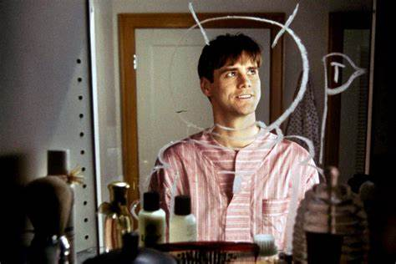
The Truman Show Truman In his bathroom in the morning
Notes:
The reason why I chose the Truman Show
I chose the Truman show, because although Truman (the main character) believes he lives in the real world, he realizes little by little that it is a made-up world and thus, he makes plans to escape. This image shows what Truman does every morning in the bathroom of his invented world. It shows him as an astronaut planting a flag with his initial on it, drawn on his mirror. It is a way for him to show his desire to leave his perfect world and to go on an adventure. This created world, in which his job is to be an actor in plays is a “mise en abime” because his life is a TV series. This is a good example of how a utopian society has its limits.

Slide 11

Destroys oneself and makes one horrible

Slide 12
Joker: A Powerful Psychological Drama Arash Javanbakht M.D.
Beginning: A Sad Child and a Man Lost in Chaos
Arthur is deeply sad and confused. His job contradicts his feelings, which he hides behind the makeup. He was beaten up by others, physically and emotionally, all his life. Every day he came home to take care of a mother who was not able to care for him when he was a child. A mother who had raised him in a distorted reality: Things are good although they are terrible. Arthur is deeply confused about his place in the world, what is real, and what is fantasy.
When alone, Arthur is most of the time naked, a clear contrast to his daily life hiding behind a mask. He does not have a sense of identity; instead, he is empty. He colors his emptiness with makeup, and his deep agony with a fake smile drawn on his face. Then, are the terribly untimely, annoying, and agonizing laughter attacks.
Psychology today, 2018
Notes:
Explaining the article, The Joker (the psychiatrist)
The Joker has a complex personality that has shifting feelings. He slowly shifts identity and thus character behavior. His path to this new dangerous identity is bloody. He must cut his bonds with the people he is attached to, such as his mother. He learns later that she had a psychological condition, which results in him discovering that the world he grew up in was actually the opposite of the reality. He learns that he was abused by his biological father and thus, it explains in part what drives him to kill.

Slide 13
Makes worse to make better

Slide 14

Goodbye Lenin! Wolfgang Becker
Notes:
Why I chose Goodbye Lenin:
Goodbye Lenin is a good example of society being able to destroy you while giving you the impression that you are building yourself. The narrator's mother, despite initially making plans to escape east Germany, then accepts the belief that the regime is utopian, the reality is that she lives in is a dystopian world. She still decides to adapt to it and when she is in her first comma, that lasts until after the fall of the Berlin Wall and the Communist regime. Her eldest son chooses to lie to her and to maintain her belief that the communist regime is still in power, as any shock could kill her. This film is an example of how a political system can provide a structure for your life and when it is taken away it can destabilize or destroy you.

Slide 15
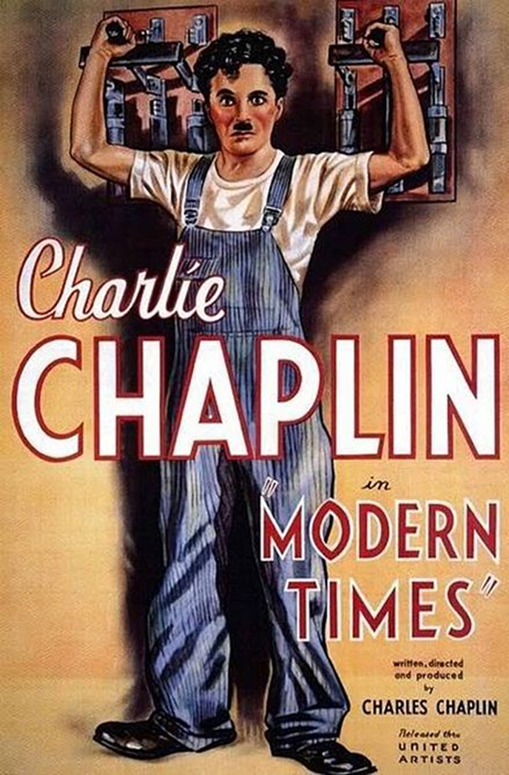
Charlie Chaplin: Modern Times
Explaining Modern Times from Charlie Chaplin:
This film presents Charlie Chaplin in his Tramp persona, as a factory worker, employed on an assembly line. There, he is subjected to such indignities as being force-fed by a malfunctioning "feeding machine" and an accelerating assembly line where he screws nuts at an ever-increasing rate onto pieces of machinery. He finally suffers a nervous breakdown and runs amok; getting stuck within a machine and throwing the factory into chaos. He is sent to a hospital. Following his recovery, the now unemployed factory worker is mistakenly arrested as an instigator in a Communist demonstration. In jail, he accidentally ingests smuggled cocaine, mistaking it for salt. In his subsequent delirium, he avoids being put back in his cell. When he returns, he stumbles upon a jailbreak and knocks the convicts unconscious. He is hailed as a hero and given special treatment. When he is informed that he will soon be released due to his heroic actions, he argues unsuccessfully that he prefers life in jail.
This surprising behavior shows that sometimes, what we think is a good world, sometimes can be revealed as a form of hell and other times, it is what we generally think as hell actually is a suitable or good place. Such as the factory and the prison.

Slide 16
Conclusion
To Conclude:
Society can help you build yourself as it can destroy you. As seen in the previous documents, some have tried to improve their lives but then have fallen whereas others have chosen to fall. When faced with the truth, it isn’t always easy to pick yourself up when you realize that all you thought was real and all you thought you had was a complete or partial lie.
A person’s desire to survive is so strong that what ever society might throw at them they will still pull through and adapt to new circumstances. So society can’t really ever totally destroy somebody but it can change them, for better, for worse. Another example is Primo Levi’s book “If this is a man” which beautifully illustrates the capacity of human nature to survive.

Slide 17
Dystopia Credits:
Mind map (created by me):
https://mm.tt/1705168786?t=SJMt48j3uG
Of mice and men (When George shoots Lennie):
https://archive.org/details/in.ernet.dli.2015.507266/page/n183/mode/2up
George Orwell – 1984 (Part I, Chapter 1):
https://archive.org/details/1984GeorgeOrwell_201810/mode/2up
Oscar Wild, The importance of being Ernest
https://www.owleyes.org/text/importance-being/read/act-i
The joker (analysis):
https://www.psychologytoday.com/us/blog/the-many-faces-anxiety-and-trauma/201911/joker-powerful-psychological-drama
The Truman Show (extract of the morning scene) :
https://th.bing.com/th/id/OIP.B2x04OSurQpiffiAfvkcuQHaE8?pid=Api&rs=1
Goodbye Lenin (cover) :
https://4.bp.blogspot.com/-ewh93Wg7Glw/VBp_gKE9R3I/AAAAAAAANeE/GZmvuW8j2qI/s1600/goodbye-lenin%2Bposter.jpg

